Slide 1
Tekton - Overview Why a new open-source CI/CD framework is needed for developers to build, test, deploy? —

Slide 2

Contents
What is Tekton?
History of Tekton
Tekton Concepts and Examples
Tekton Features
Tekton & Kabanero, Goals

Slide 3
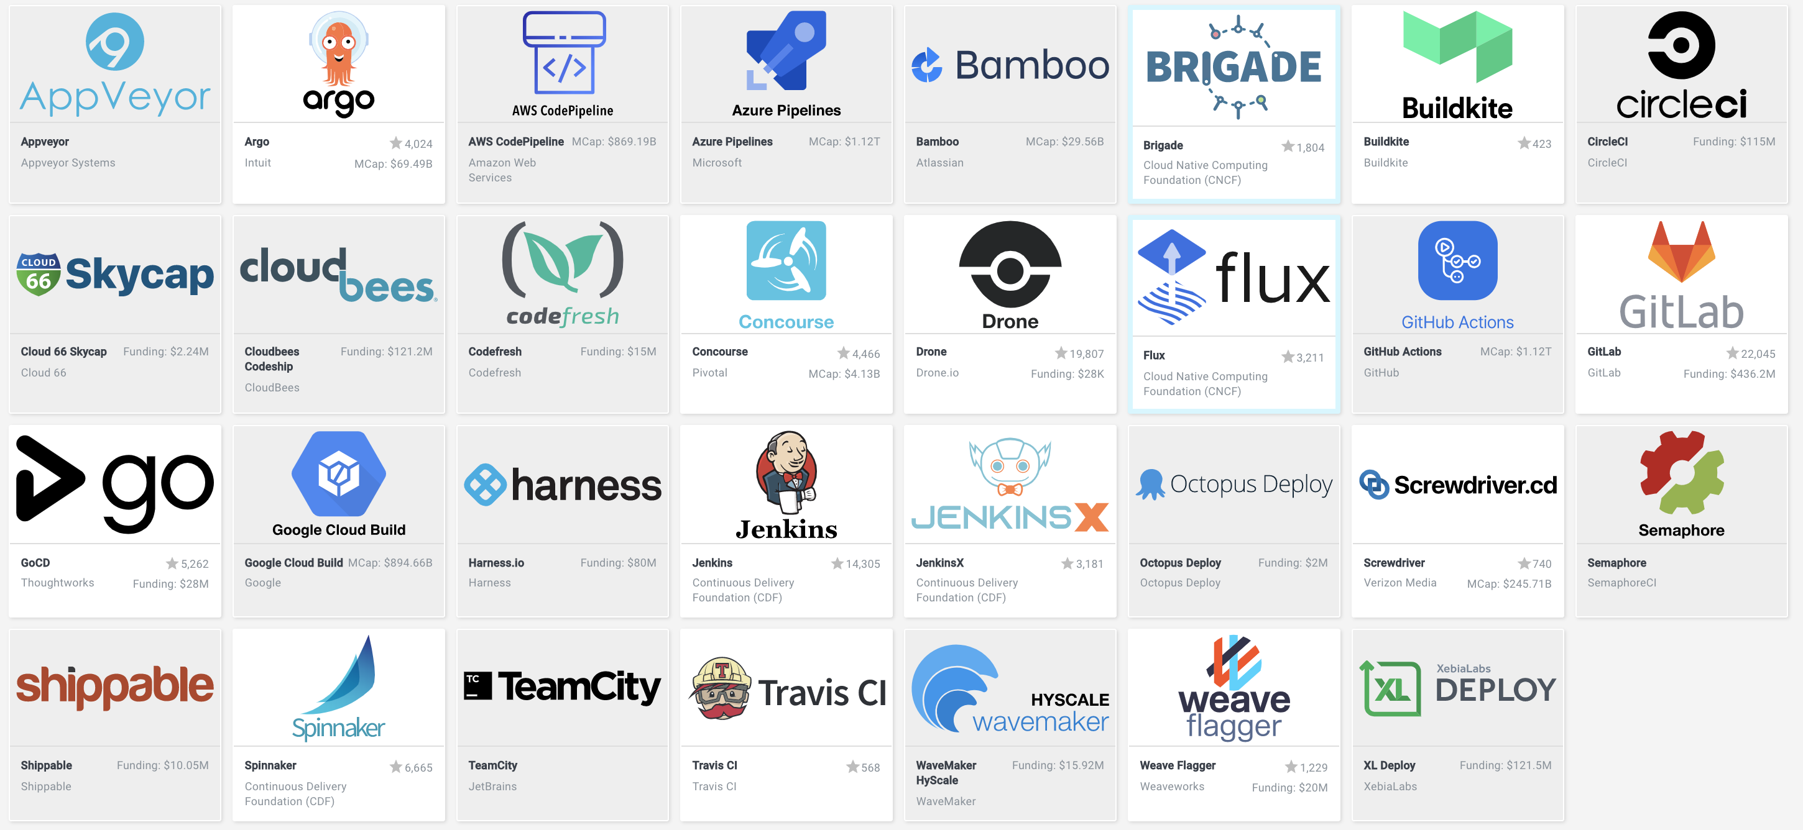
Industry Challenges
Competing projects
Conflicting Terminology
Achieving the same goal Why?
Scale
Standardization (.yaml)
Best practices of K8s
Deploy to multiple platforms (serverless, K8s, VMs)
Run pipelines in containers
Flexible (own workflows)
Image from CNCF Landscape: https://landscape.cncf.io/

Slide 4
Tekton provides Kubernetes-style resources for declaring CI/CD concepts

Slide 5
Tekton Emerges
Spun out of the Knative build project
Git Repo: https://github.com/tektoncd
Current release: 0.10.0 (January 2020) https://tekton.dev/
First release: 0.2.0 (March 2019)
Contributors: Google, Red Hat, Pivotal, IBM, etc.
Part of the CD Foundation (under the Linux Foundation)
Includes other open source projects such as: JenkinsX, Jenkins, Spinnaker, Tekton
CD Foundation announced in March 2019
Goal: To serve as the vendor-neutral home for the most important open source projects for continuous delivery
TEKTON
JENKINSX
SPINNAKER
JENKINS

Slide 6

So, what is Tekton?
Composable
Typed
Cloud Native: Run on Kubernetes, has Kubernetes clusters as a first-class type, use containers as their building blocks
Typed: You can switch implementations for specific types of resources, such as images.(e.g. building with kaniko v.s. buildkit)
Composable: Tekton concepts build upon each other
Decoupled: The Tasks which make up a Pipeline can easily be run in isolation. One Pipeline can be used to deploy to any k8s cluster
Decoupled
Cloud Native
Notes:
The concept of typed resources means that resources can swap out implementations

Slide 7
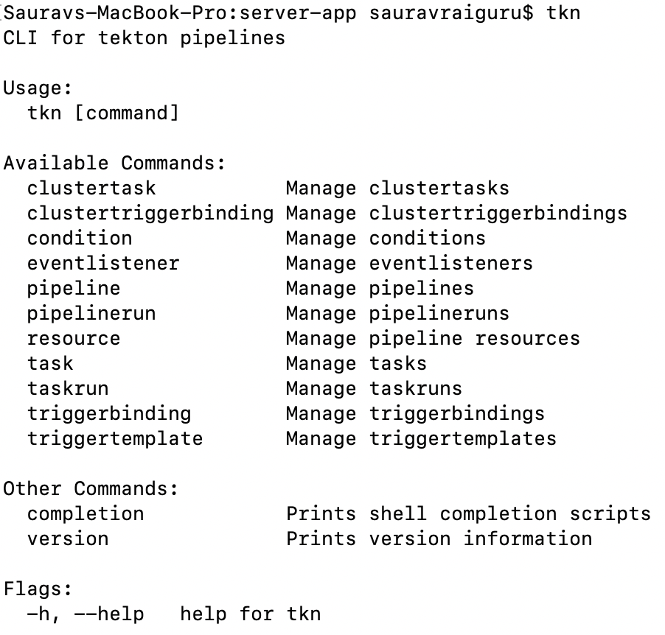
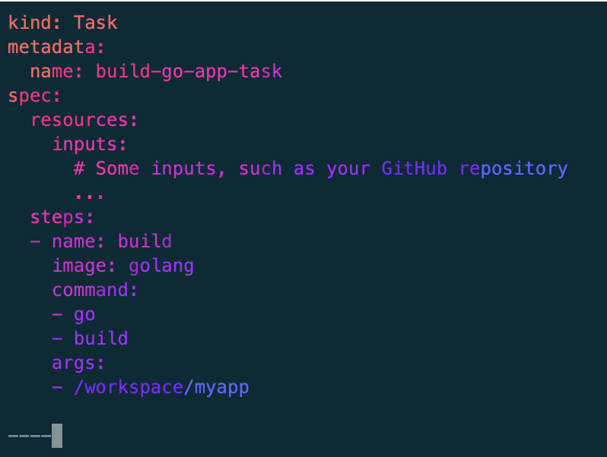
Tekton – works on the concept of CRDs in K8s & controllers
CRDs – Extend Kubernetes with custom types.
Controllers - Continually works to archive your desired state & act on the resources
Create
Update
Delete
These two together make a CI/CD platform on Kubernetes called ‘Tekton’ consisting of Pipelines, Tasks, Steps etc.
Therefore, CRDs + Controllers = Declarative API

Slide 8
Tekton Pipelines – Concepts
Step – Run commands in a container with volume & env vars etc.
Task – List or a series of steps that will launch specific build that ingest specific inputs and produce specific outputs.
Task Run – Instantiates a Task for execution with specific inputs, outputs, and execution parameters. Can be invoked on its own or as part of a Pipeline.
Pipeline –Defines a series of Tasks that accomplish a specific build or delivery goal. Can be triggered by an event or invoked from a Pipeline Run.
Pipeline Run – Instantiates a Pipeline for execution with specific inputs, outputs, and execution parameters.
Pipeline Resources – Defines locations for inputs ingested and outputs produced by the steps in Tasks

Slide 9
Tekton Concept: Step
The smallest building block
Specify images, commands, arguments
Is a container
steps:
- name: echo
image: ubuntu
command:
- echo
args:
- "hello world"

Slide 10
Tekton CRD: Task
New CRD
Sequence of Steps
Run in sequential order
Reusable
Perform a specific task
Runs on the same k8s node as a pod
apiVersion: tekton.dev/v1alpha1
kind: Task
metadata:
name: echo-hello-world
spec:
steps:
- name: echo
image: ubuntu
command:
- echo
args:
- "hello world"

Slide 11
Tekton Runtime CRDs
apiVersion: tekton.dev/v1alpha1
kind: PipelineRun
metadata:
name: tutorial-pipeline-run-1
spec:
serviceAccountName: tutorial-service
pipelineRef:
name: tutorial-pipeline
resources:
- name: source-repo
resourceRef:
name: skaffold-git
- name: web-image
resourceRef:
name: skaffold-image-leeroy-web
Instances of Pipelines and Tasks :
PipelineRun
TaskRun
Runtime info such as registry information, git repo or other specific inputs, outputs, and execution parameters.

Slide 12
Tekton CRD: Pipeline
apiVersion: tekton.dev/v1alpha1
kind: Pipeline
metadata:
name: tutorial-pipeline
spec: - name: build-app
taskRef:
name: build-push
resources:
outputs:
- name: image
resource: my-image
- name: deploy-app
taskRef:
name: deploy-kubectl
resources:
inputs:
- name: image
resource: my-image
from:
- build-app
Expresses Tasks
Sequentially
Concurrently
Links input and output
Execute Tasks on different nodes

Slide 13
Putting it all together
Setup test environment
Linting
Build images
Run end to end tests
Publish images
Deploy
Unit tests
Run integration tests

Slide 14
Putting it all together
Pipeline
Task
Task
Setup test environment
Linting
Task
Task
Task
Build images
Run end to end tests
Publish images
Deploy
Unit tests
Run integration tests
Step
Step
Step
Step
Step
Step
Task
Step
Step
Step
Task

Slide 15
Tekton - Execution
DEVELOPER
PIPELINE RESOURCE
GIT PUSH
GIT IMAGE REPO
T
T
T
PIPELINE YAML
S
APP1
PIPELINE
RUN
S
EXECUTION
K8s Image Registry
SEQUENCE
PIPELINE
APP2
K8s
NAMESPACE
REG.
TEKTON
TASKS
WEBHOOK

Slide 16
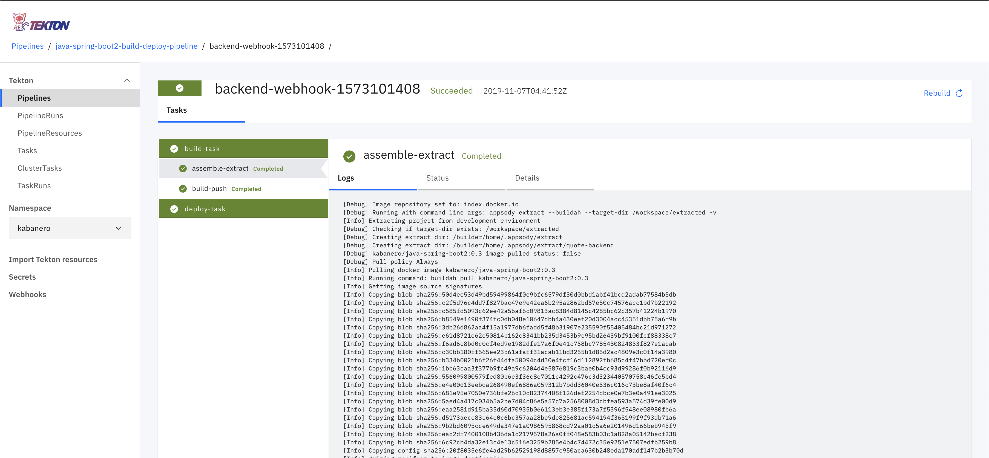
Tekton Features: Dashboard
https://github.com/tektoncd/dashboard
Output from a PipelineRun

Slide 17
Tekton Features: CLI
https://github.com/tektoncd/cli
$ tkn --help
CLI for tekton pipelines
Usage:
tkn [command]
Available Commands:
clustertask Manage clustertasks
condition Manage conditions
pipeline Manage pipelines
pipelinerun Manage pipelineruns
resource Manage pipeline resources
task Manage tasks
taskrun Manage taskruns
Other Commands:
completion Prints shell completion scripts
version Prints version information

Slide 18
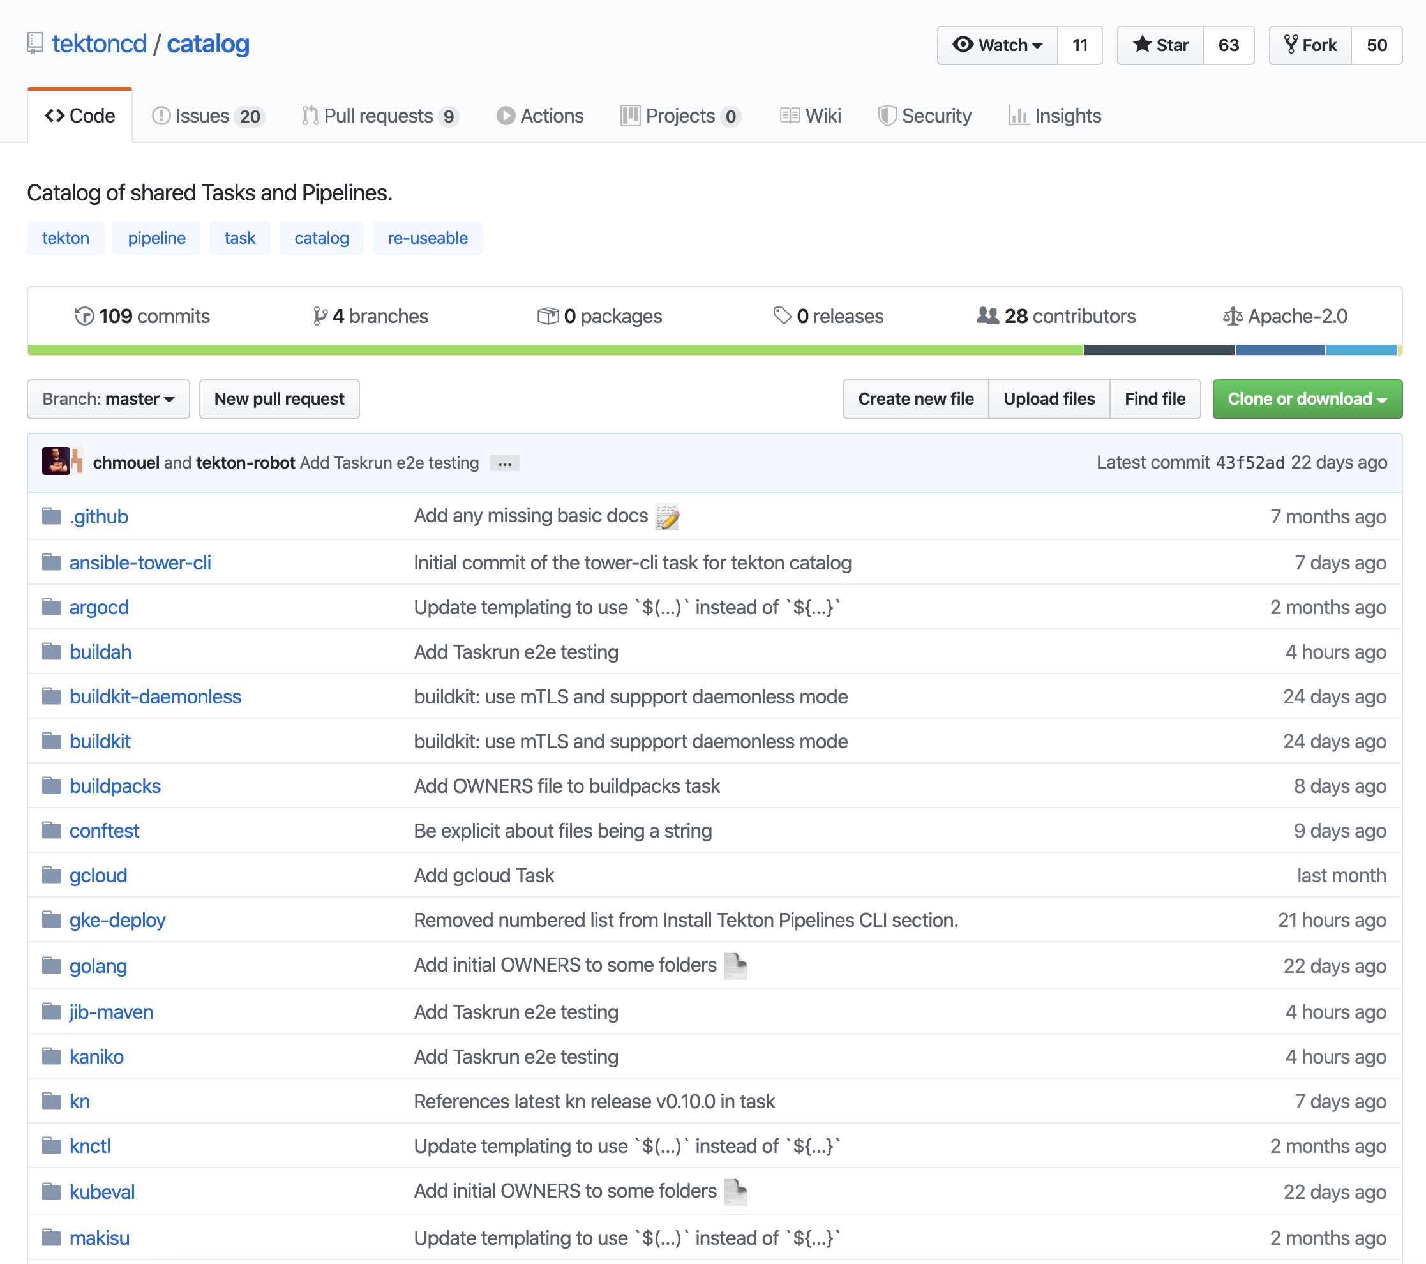
Tekton Features: Catalog
https://github.com/tektoncd/catalog
This repository contains a catalog of Task resources, designed to be reusable in many pipelines.

Slide 19
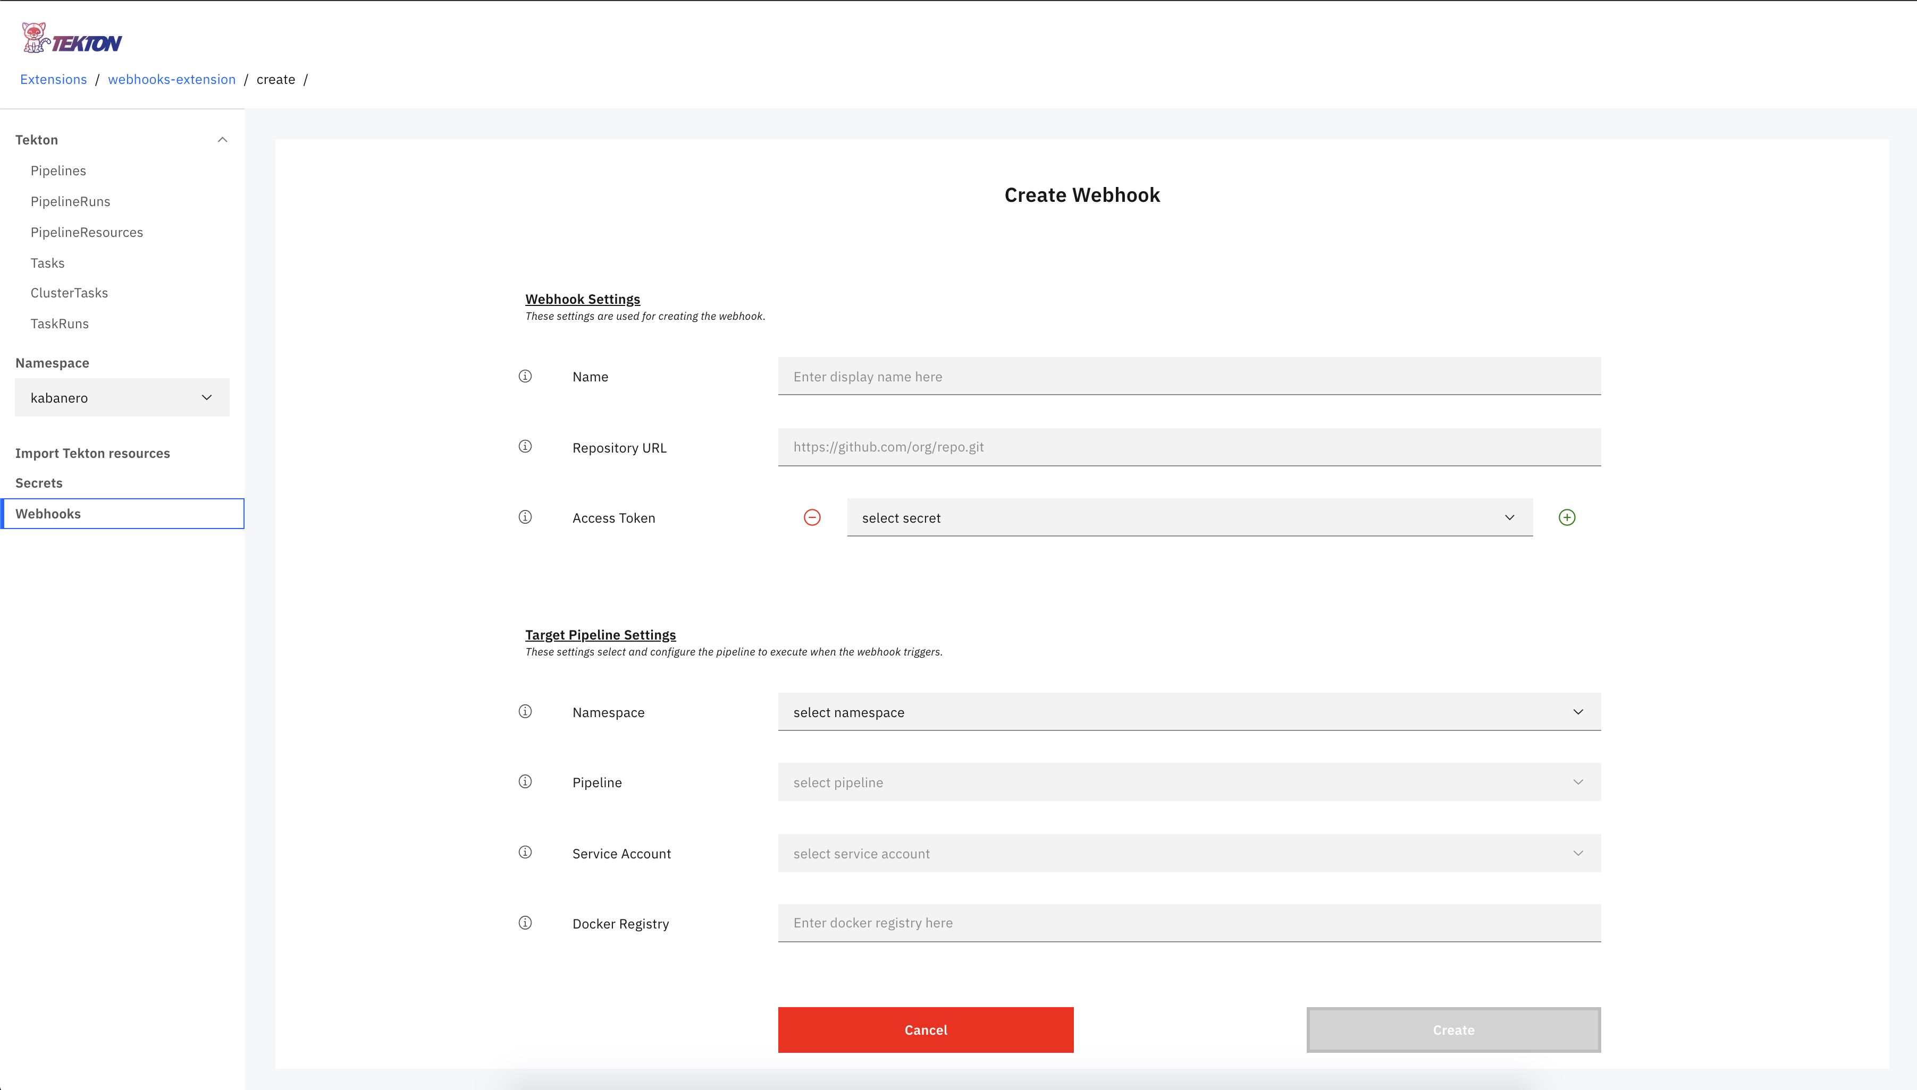
Tekton Features: Webhooks
https://github.com/tektoncd/experimental/tree/master/webhooks-extension
Allows users to set up GitHub webhooks that will trigger PipelineRuns and TaskRuns.

Slide 20
Tekton Features: Triggers & Event listeners
https://tekton.dev/docs/triggers/
Triggers enables users to connect / map fields from an event payload into resource templates. triggerBinding – binds with events. triggerTemplate – template consisting of resources to be called.

Slide 21
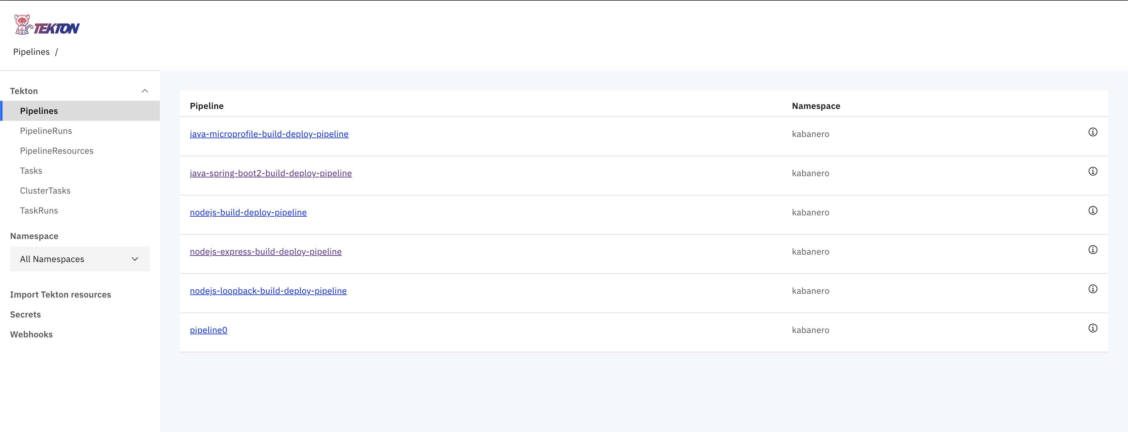
Tekton with Kabanero
https://github.com/kabanero-io/kabanero-pipelines
Each Stack in Kabanero comes with a default pipeline (named <lang>-build-deploy).
The pipeline consists of two tasks: One to build the appsody stack, the second to deploy the appsody stack

Slide 22
Tekton Project Goals
Goals
Specify the “API” and provide the “building blocks” for running build pipelines
Host a community of sub-projects that extend Tekton (Dashboard UI, CLI, Webhooks, etc.)
Provide a catalog of best practices for authoring pipelines and tasks. So, that we can mix & match common blocks.

Slide 23
Tekton – where to deploy / where can I run it?
Almost everywhere or anywhere.. wherever you find Kubernetes (container platform) ☺
Its an integral part of OpenShift and Cloud Pak for Applications.
On IBM Cloud - https://www.ibm.com/cloud/tekton
Resources
https://tekton.dev/
https://developer.ibm.com/components/tekton/
https://www.youtube.com/watch?v=TWxKD9dLpmk
https://github.com/tektoncd

